Slide 1
MODERN OPERATING SYSTEMS
Third Edition
ANDREW S. TANENBAUM
Chapter 10
Case Study 1: LINUX
Tanenbaum, Modern Operating Systems 3 e, (c) 2008 Prentice-Hall, Inc. All rights reserved. 0-13-6006639

Slide 2
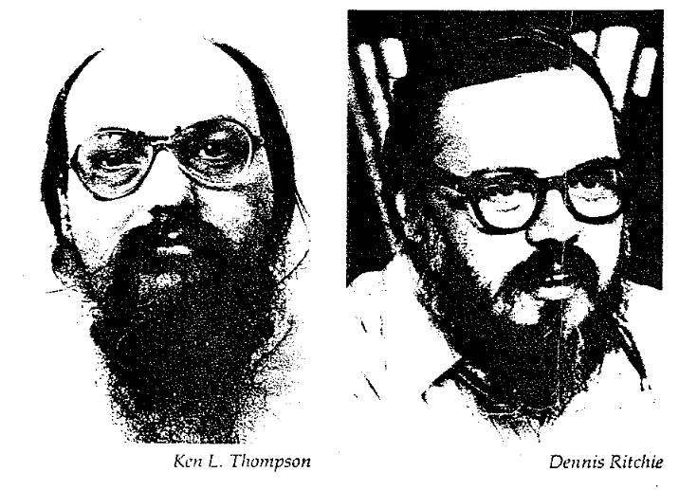
HISTORY of Unix (1)
MULTICS (M.I.T., Bell Labs, & GE)
  MULTiplexed Information and Computing Service
Bell Labs pulls out and Ken Thompson looks for something to do
  Writes a stripped down version of MULTICS by himself for a PDP-7.
Brian Kernighan names it UNICS
  UNiplexed Information and Computing Service
Dennis Ritchie joins the effort and UNIX is ported to PDP-11/45 and PDP-11/70 (dominate minicomputers of 1970’s)
UNIX is rewritten in high-level language
  B was simplified version of BCPL (Basic CPL), a descendent of CPL (Combined Programming Language). (Alternate version: B was derived from Bon an earlier language that Thompson wrote which, in turn, was named after his wife, Bonnie.)
  Dennis Ritchie designed a successor to B and named it C.

Slide 3




HISTORY of Unix (2)
AT&T (owner of Bell Labs) distributes UNIX to universities for a modest fee.
University of California at Berkeley ports UNIX to the VAX (4BSD) and implements virtual memory, long filenames, a better file system, the network protocol TCP/IP, a new editor (vi), a new shell (csh), and new compilers (Pascal & Lisp).
In 1987, Andrew Tanenbaum releases a new stripped-down version called MINIX that could be used by O.S. classes.
In 1991, Finnish student, Linus Torvalds, added features to MINIX and releases a full-blown UNIX clone named Linux.

Slide 4
Unix / Linux Goals
  Designed by programmers for programmers
    “What they want is a servant, not a nanny.”
  Simple, elegant, and consistent design
  “Principle of least surprise”
  Power and Flexibility
  Commands should do just one thing and do it well
  Avoid useless redundancy
  use cp instead of copy

Slide 5
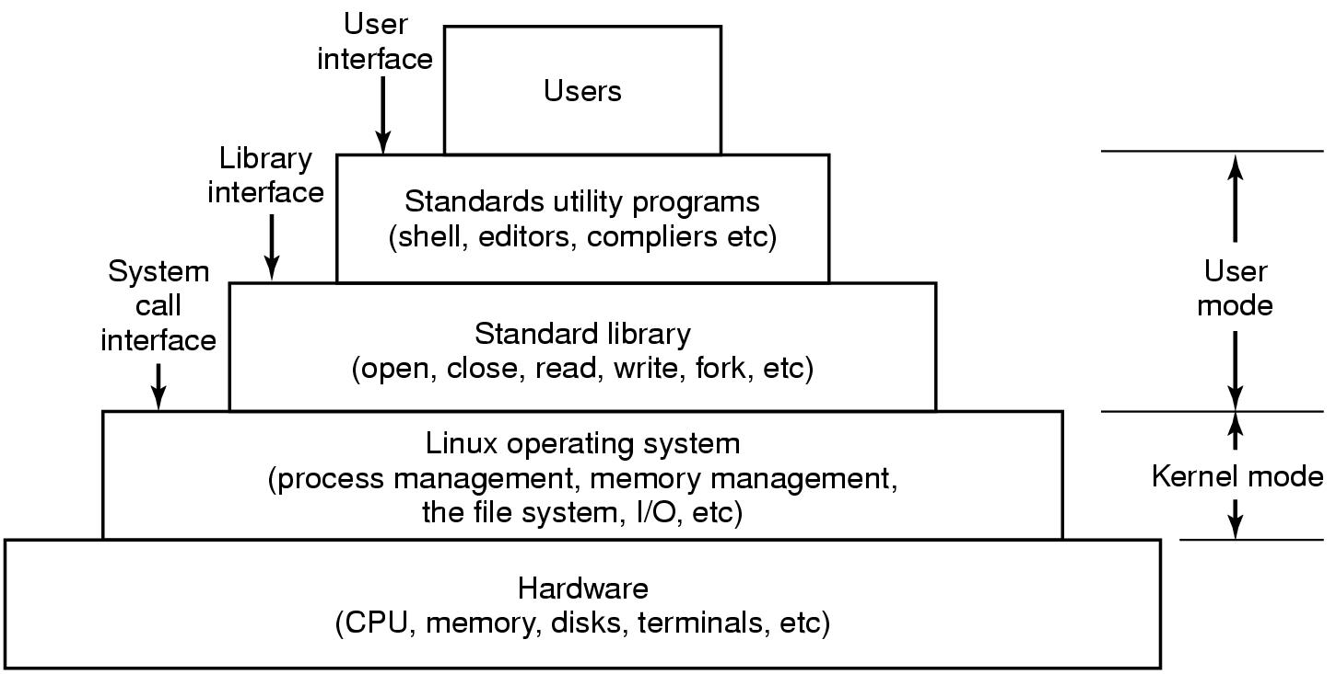
Interfaces to Linux
Figure 10-1. The layers in a Linux system.
Tanenbaum, Modern Operating Systems 3 e, (c) 2008 Prentice-Hall, Inc. All rights reserved. 0-13-6006639

Slide 6
UNIX Shells
sh (Bourne shell): The earliest major UNIX shell was written by Steve Bourne in 1979.
csh (C shell): Written by Bill Joy as a part of the Berkeley project. Adds C-like operators, and command-line recall.
ksh (Korn shell): Combines features of sh and csh as well as some new features. Written by David Korn in 1986.
bash (Bourne-again shell): Developed as part of the GNU project. It is a POSIX-conforming shell that includes some of the best features of csh and ksh as well as adding some of its own. This is the default shell used by TAZ.

Slide 7
Linux Utility Programs (1)
Categories of utility programs:
File and directory manipulation commands.
Filters.
Program development tools, such as editors and compilers.
Text processing.
System administration.
Miscellaneous.
Tanenbaum, Modern Operating Systems 3 e, (c) 2008 Prentice-Hall, Inc. All rights reserved. 0-13-6006639

Slide 8
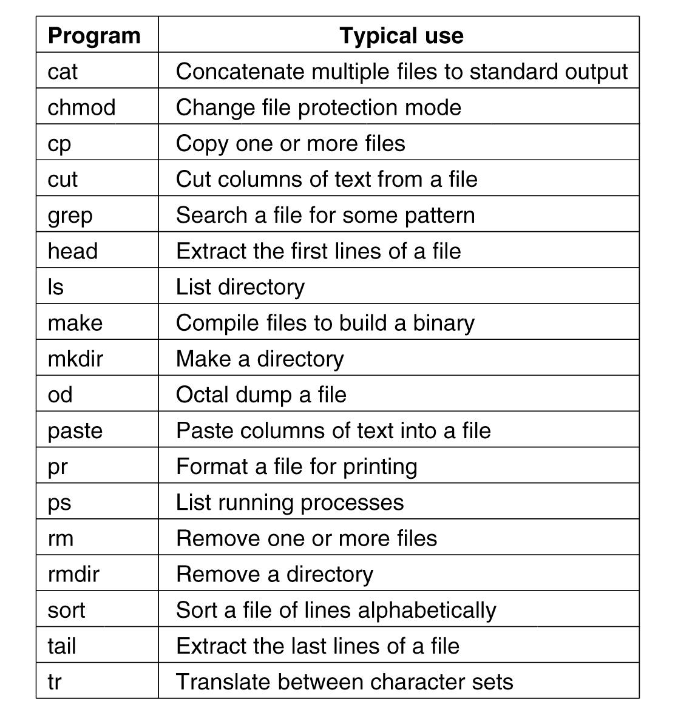
Linux Utility Programs (2)
Figure 10-2. A few of the common Linux
utility programs required by POSIX.
Tanenbaum, Modern Operating Systems 3 e, (c) 2008 Prentice-Hall, Inc. All rights reserved. 0-13-6006639

Slide 9
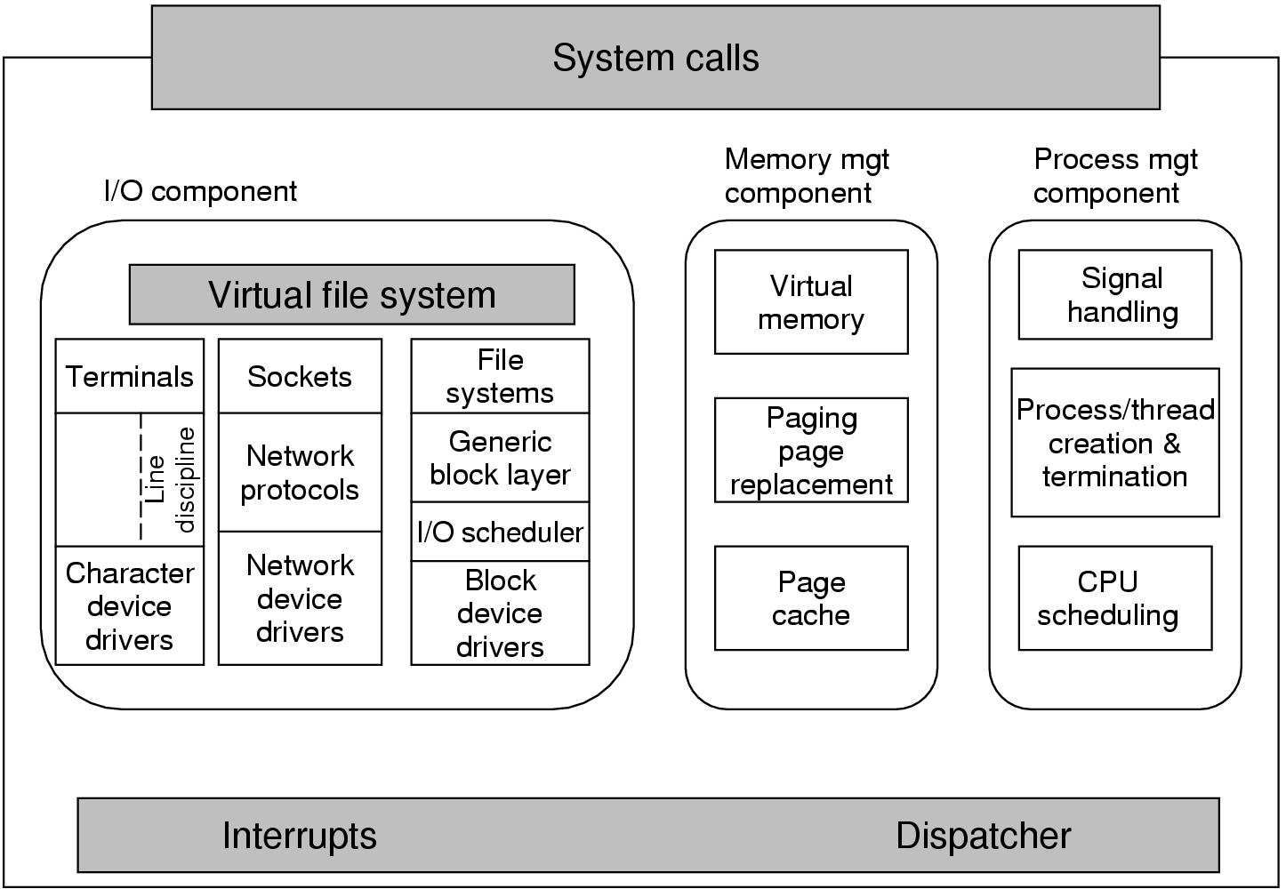
Kernel Structure
Figure 10-3. Structure of the Linux kernel
Tanenbaum, Modern Operating Systems 3 e, (c) 2008 Prentice-Hall, Inc. All rights reserved. 0-13-6006639

Slide 10
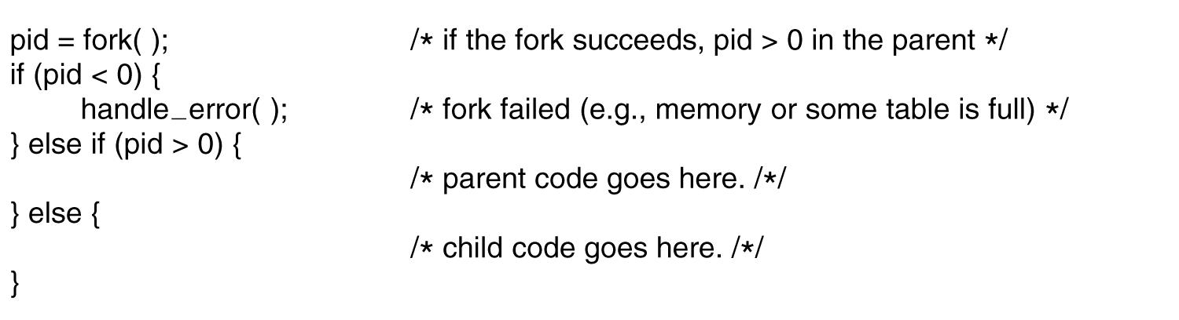
Processes in Linux
Figure 10-4. Process creation in Linux.
Tanenbaum, Modern Operating Systems 3 e, (c) 2008 Prentice-Hall, Inc. All rights reserved. 0-13-6006639

Slide 11
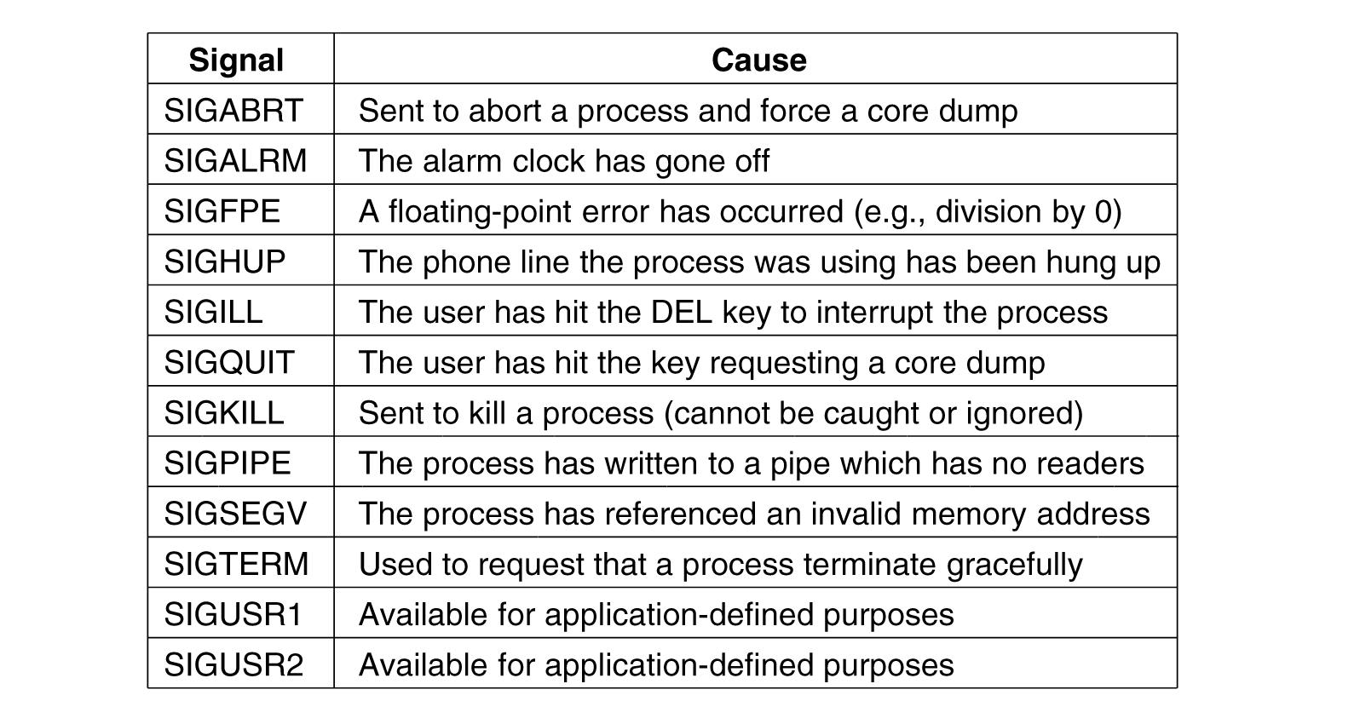
Signals in Linux (1)
Figure 10-5. The signals required by POSIX.
Tanenbaum, Modern Operating Systems 3 e, (c) 2008 Prentice-Hall, Inc. All rights reserved. 0-13-6006639

Slide 12
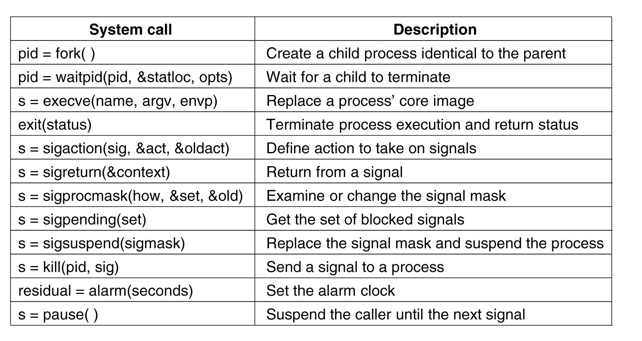
Process Management
System Calls in Linux
Figure 10-6. Some system calls relating to processes.
Tanenbaum, Modern Operating Systems 3 e, (c) 2008 Prentice-Hall, Inc. All rights reserved. 0-13-6006639

Slide 13
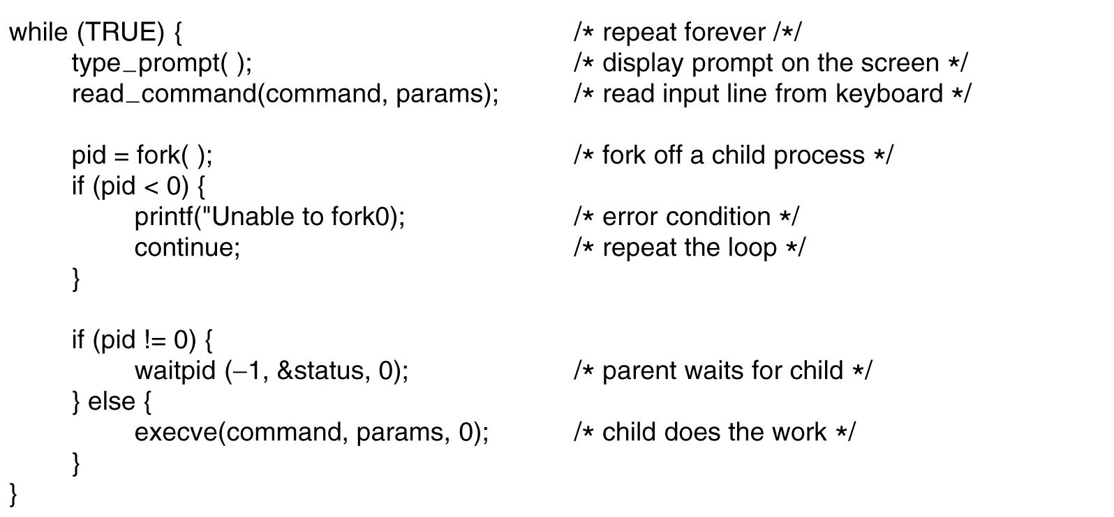
A Simple Linux Shell
Figure 10-7. A highly simplified shell.
Tanenbaum, Modern Operating Systems 3 e, (c) 2008 Prentice-Hall, Inc. All rights reserved. 0-13-6006639

Slide 14
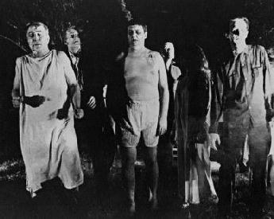
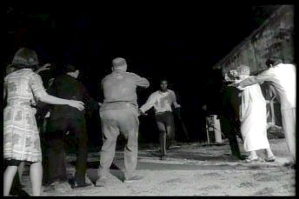
Process Zombie States
When a child process exits, it sends a message to its parent containing its exit status.
If the parent isn’t waiting for this message (or if the parent is no longer present), the child enters the zombie state.

Slide 15
Implementation of Processes and Threads
Categories of information in the process descriptor:
Scheduling parameters
Memory image
Signals
Machine registers
System call state
File descriptor table
Accounting
Kernel stack
Miscellaneous
Tanenbaum, Modern Operating Systems 3 e, (c) 2008 Prentice-Hall, Inc. All rights reserved. 0-13-6006639

Slide 16
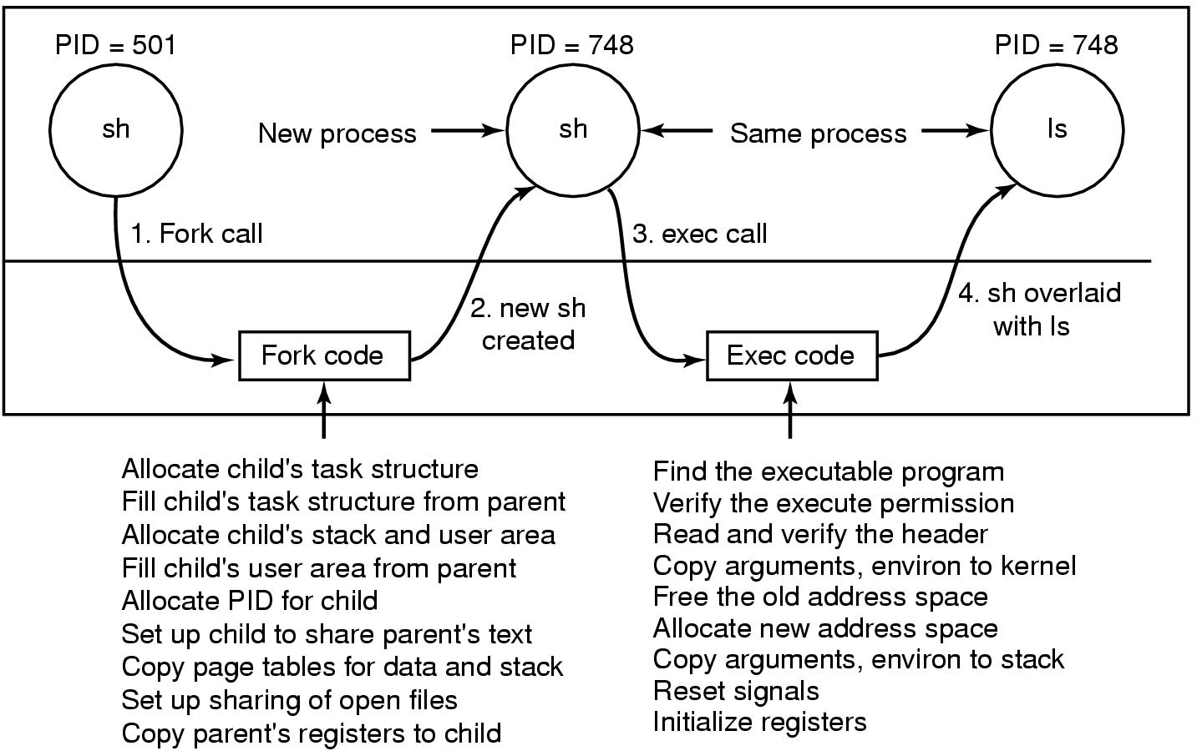
Implementation of Exec
Figure 10-8. The steps in executing the command
ls typed to the shell.
Tanenbaum, Modern Operating Systems 3 e, (c) 2008 Prentice-Hall, Inc. All rights reserved. 0-13-6006639

Slide 17
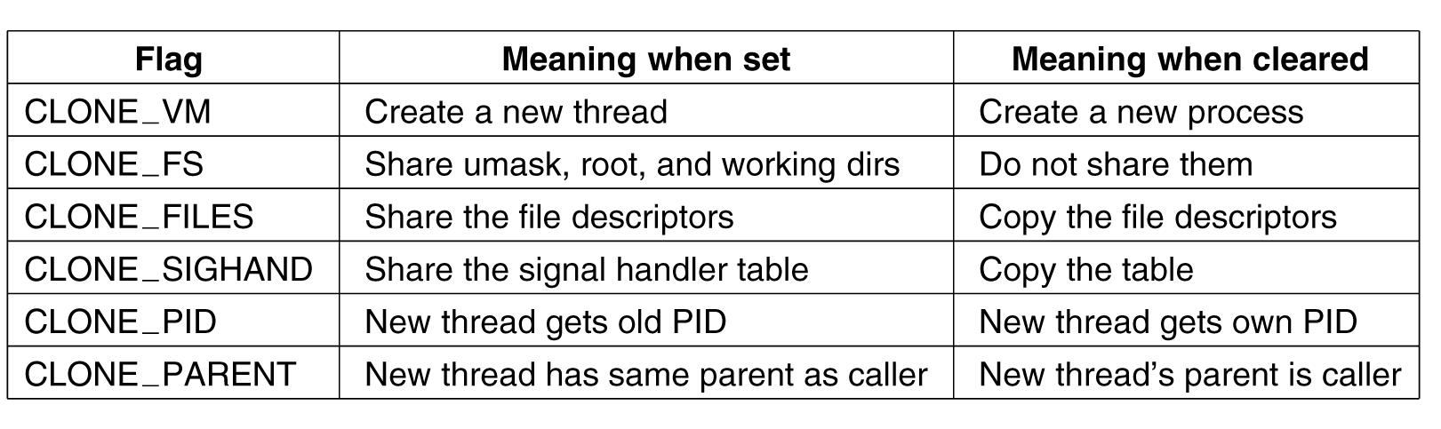
The Clone System Call
Figure 10-9. Bits in the sharing_flags bitmap.
Tanenbaum, Modern Operating Systems 3 e, (c) 2008 Prentice-Hall, Inc. All rights reserved. 0-13-6006639

Slide 18
Scheduling in Linux (1)
Three classes of threads for scheduling purposes:
Real-time FIFO. (Priorities 0 – 99; non-preemptive)
Real-time round robin. (Priorities 0 – 99; preemptive)
Timesharing. (priorites 100 – 139)
Note: Highest priority = 0
Lowest priority = 140
Tanenbaum, Modern Operating Systems 3 e, (c) 2008 Prentice-Hall, Inc. All rights reserved. 0-13-6006639

Slide 19
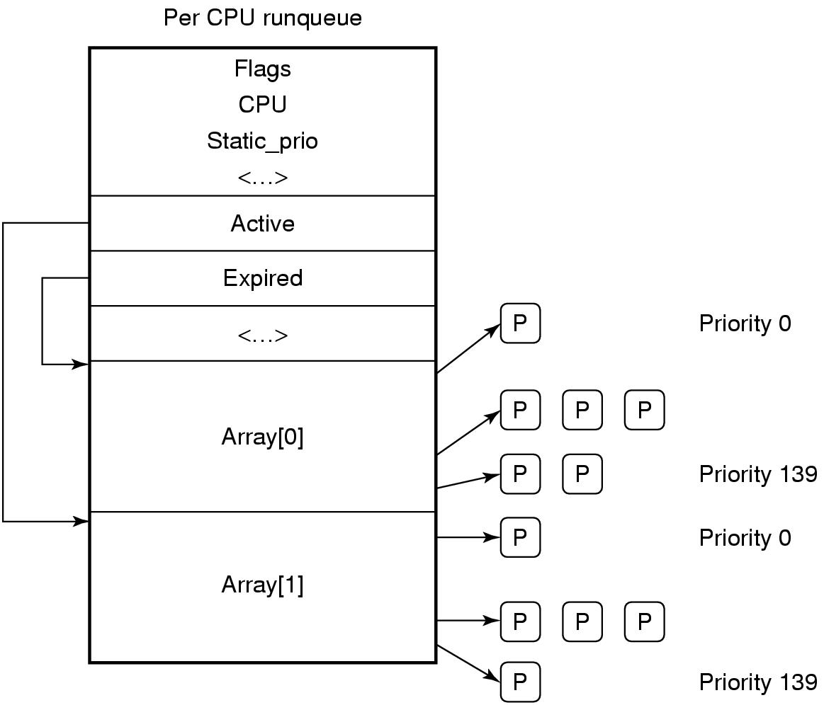
Scheduling in Linux (2)
Figure 10-10. Illustration of Linux runqueue and priority arrays.
Tanenbaum, Modern Operating Systems 3 e, (c) 2008 Prentice-Hall, Inc. All rights reserved. 0-13-6006639

Slide 20
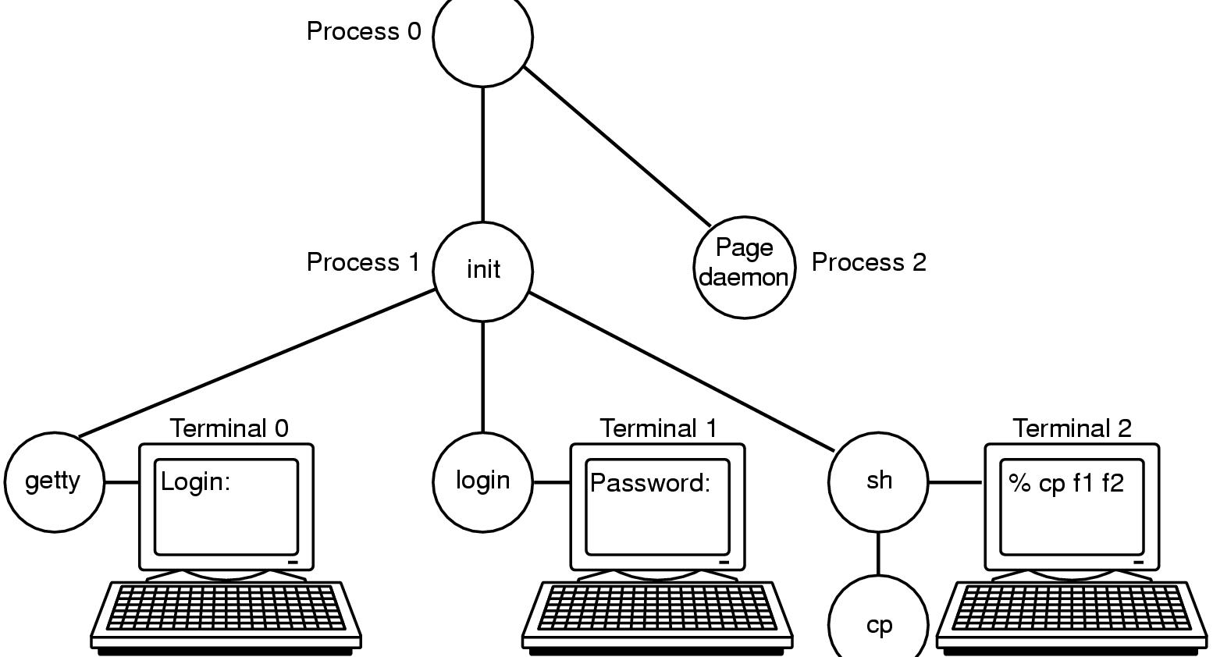
Booting Linux
Figure 10-11. The sequence of processes used to
boot some Linux systems.
Tanenbaum, Modern Operating Systems 3 e, (c) 2008 Prentice-Hall, Inc. All rights reserved. 0-13-6006639

Slide 21
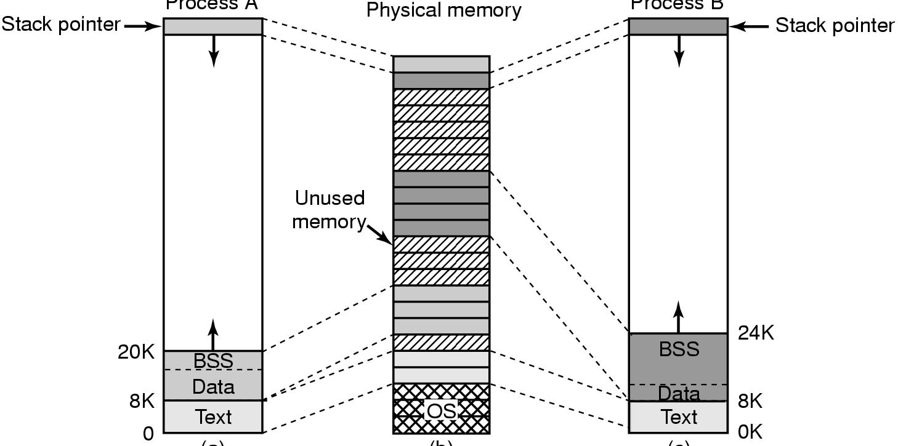
Memory Management in Linux (1)
Figure 10-12. (a) Process A’s virtual address space. (b) Physical memory. (c) Process B’s virtual address space.
Tanenbaum, Modern Operating Systems 3 e, (c) 2008 Prentice-Hall, Inc. All rights reserved. 0-13-6006639

Slide 22
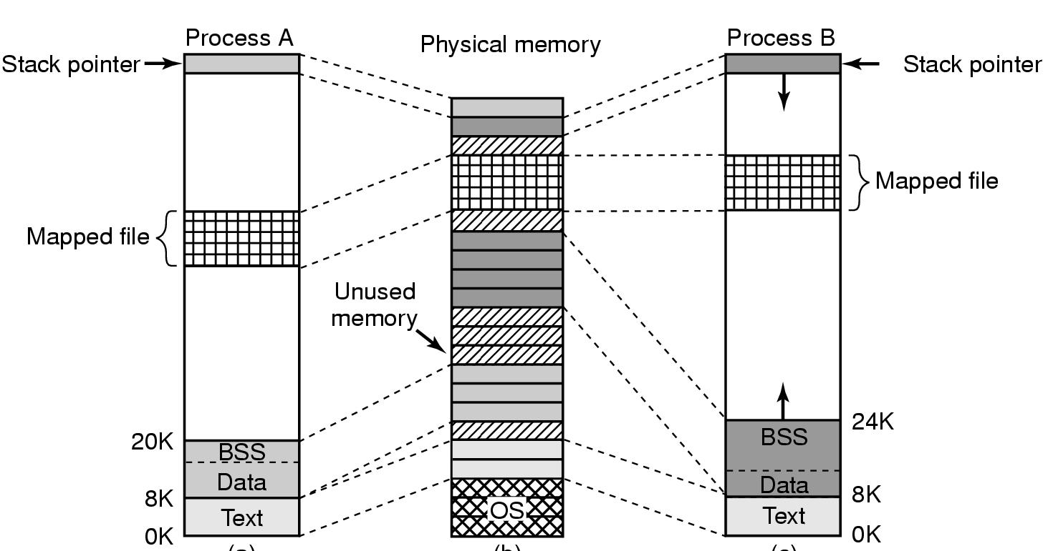
Memory Management in Linux (2)
Figure 10-13. Two processes can share a mapped file.
Tanenbaum, Modern Operating Systems 3 e, (c) 2008 Prentice-Hall, Inc. All rights reserved. 0-13-6006639

Slide 23
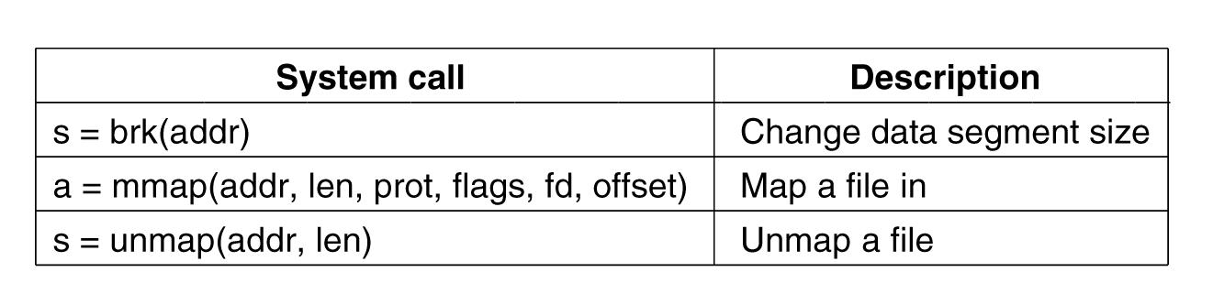
Memory Management
System Calls in Linux
Figure 10-14. Some system calls relating to memory management.
Tanenbaum, Modern Operating Systems 3 e, (c) 2008 Prentice-Hall, Inc. All rights reserved. 0-13-6006639

Slide 24
Physical Memory Management (1)
Linux distinguishes between three memory zones:
ZONE_DMA - pages that can be used for DMA operations.
ZONE_NORMAL - normal, regularly mapped pages.
ZONE_HIGHMEM - pages with high-memory addresses, which are not permanently mapped.
Tanenbaum, Modern Operating Systems 3 e, (c) 2008 Prentice-Hall, Inc. All rights reserved. 0-13-6006639

Slide 25
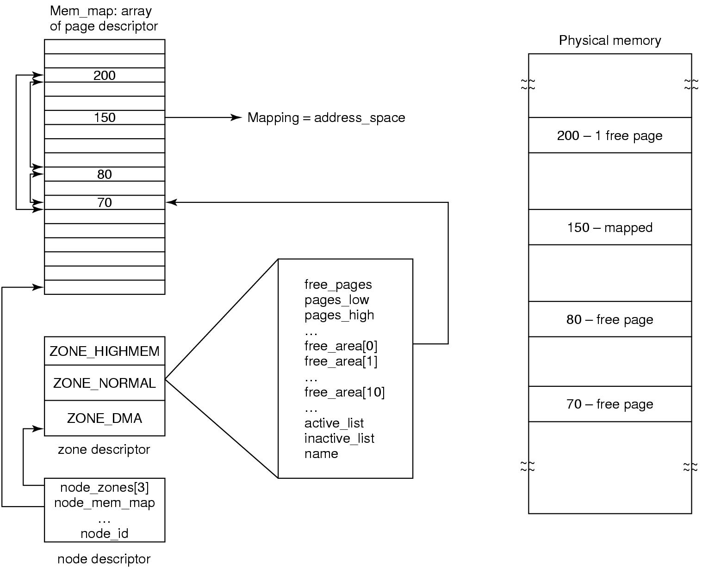
Physical Memory Management (2)
Figure 10-15. Linux main memory representation.
Tanenbaum, Modern Operating Systems 3 e, (c) 2008 Prentice-Hall, Inc. All rights reserved. 0-13-6006639

Slide 26
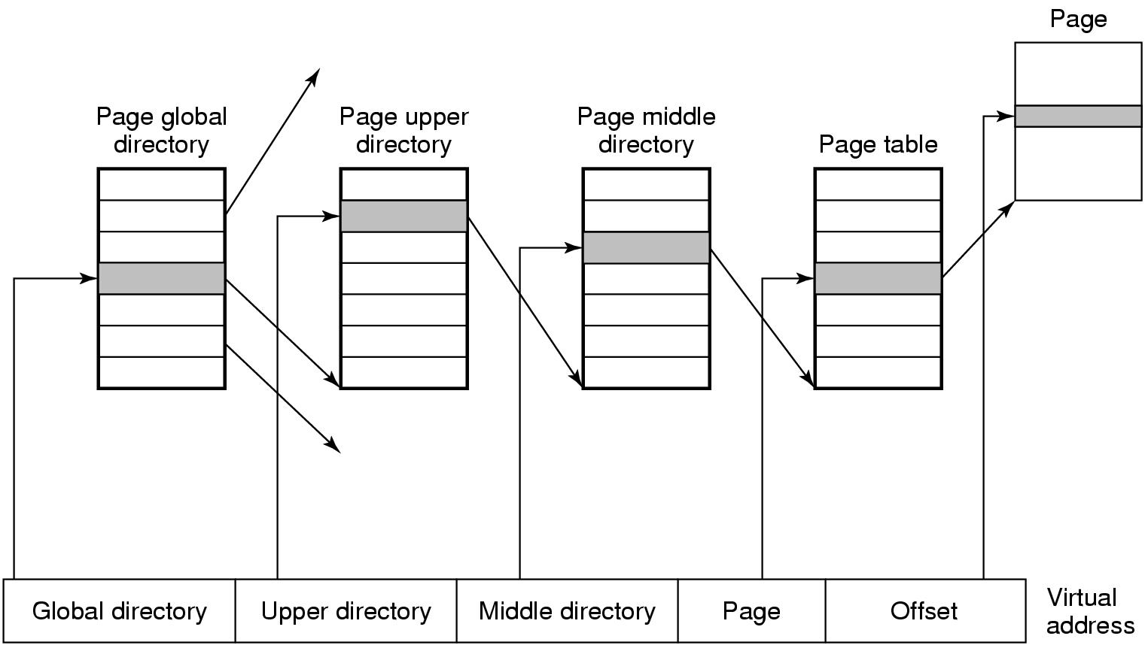
Physical Memory Management (3)
Figure 10-16. Linux uses four-level page tables.
Tanenbaum, Modern Operating Systems 3 e, (c) 2008 Prentice-Hall, Inc. All rights reserved. 0-13-6006639

Slide 27
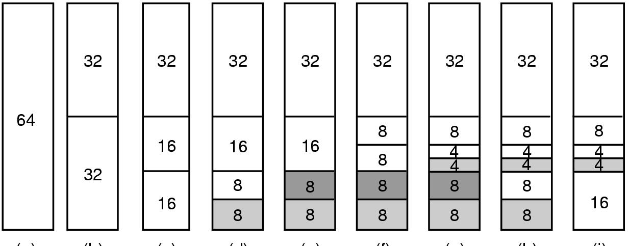
Memory Allocation Mechanisms
Figure 10-17. Operation of the buddy algorithm.
Tanenbaum, Modern Operating Systems 3 e, (c) 2008 Prentice-Hall, Inc. All rights reserved. 0-13-6006639

Slide 28
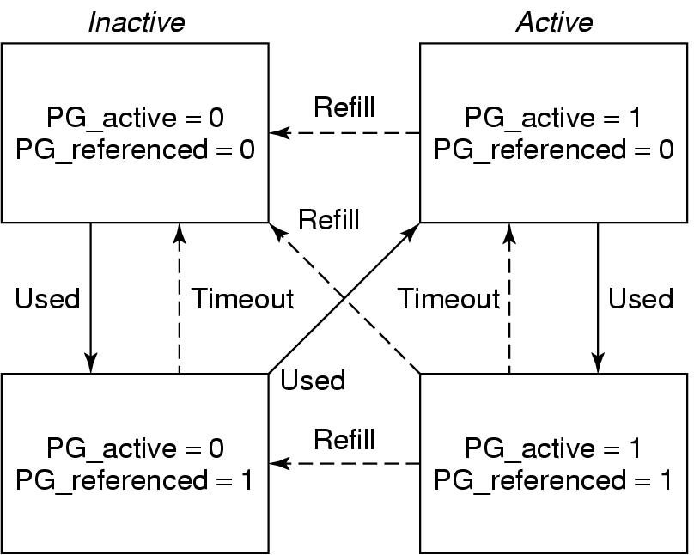
The Page Replacement Algorithm
Figure 10-18. Page states considered in the page
frame replacement algorithm.
Tanenbaum, Modern Operating Systems 3 e, (c) 2008 Prentice-Hall, Inc. All rights reserved. 0-13-6006639

Slide 29
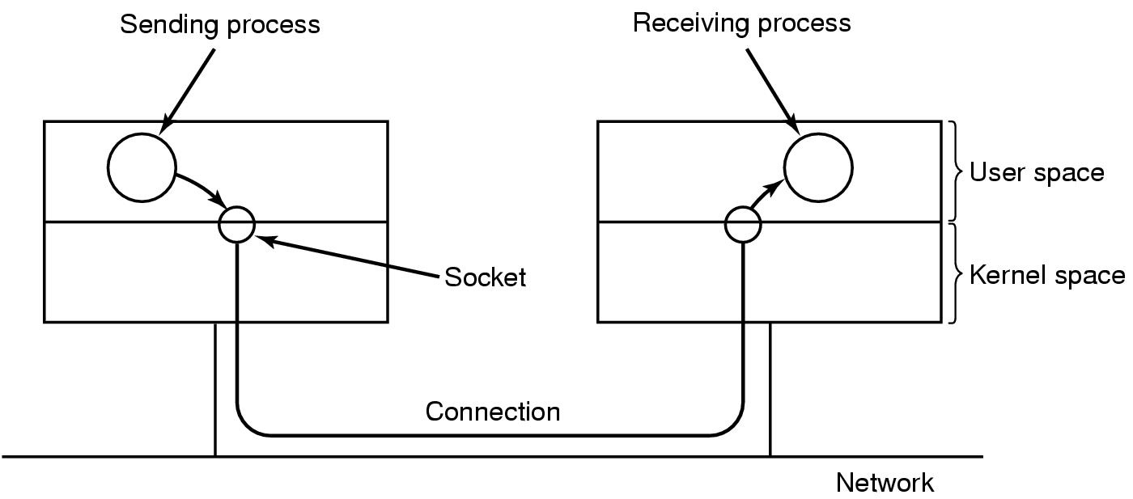
Networking (1)
Figure 10-19. The uses of sockets for networking.
Tanenbaum, Modern Operating Systems 3 e, (c) 2008 Prentice-Hall, Inc. All rights reserved. 0-13-6006639

Slide 30
Networking (2)
Types of networking:
Reliable connection-oriented byte stream.
Reliable connection-oriented packet stream.
Unreliable packet transmission.
Tanenbaum, Modern Operating Systems 3 e, (c) 2008 Prentice-Hall, Inc. All rights reserved. 0-13-6006639

Slide 31
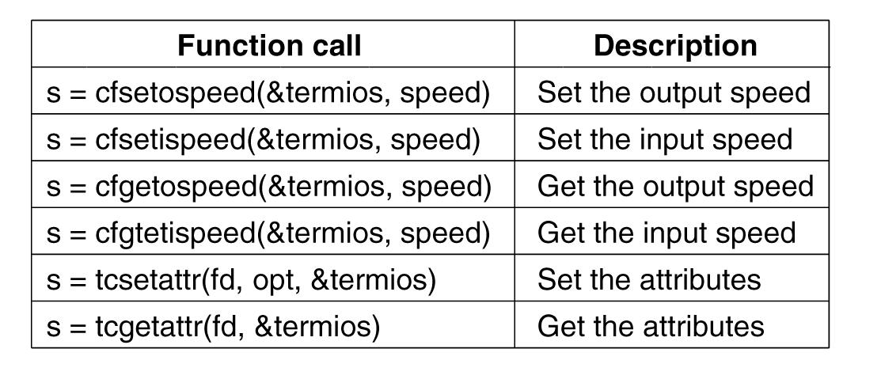
Input/Output System Calls in Linux
Figure 10-20. The main POSIX calls for managing the terminal.
Tanenbaum, Modern Operating Systems 3 e, (c) 2008 Prentice-Hall, Inc. All rights reserved. 0-13-6006639

Slide 32
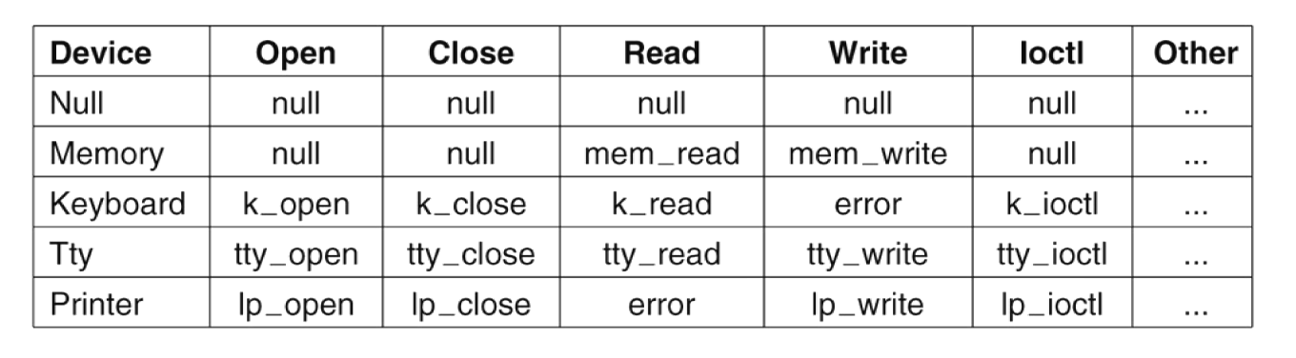
The Major Device Table
Figure 10-21. Some of the file operations supported
for typical character devices.
Tanenbaum, Modern Operating Systems 3 e, (c) 2008 Prentice-Hall, Inc. All rights reserved. 0-13-6006639

Slide 33
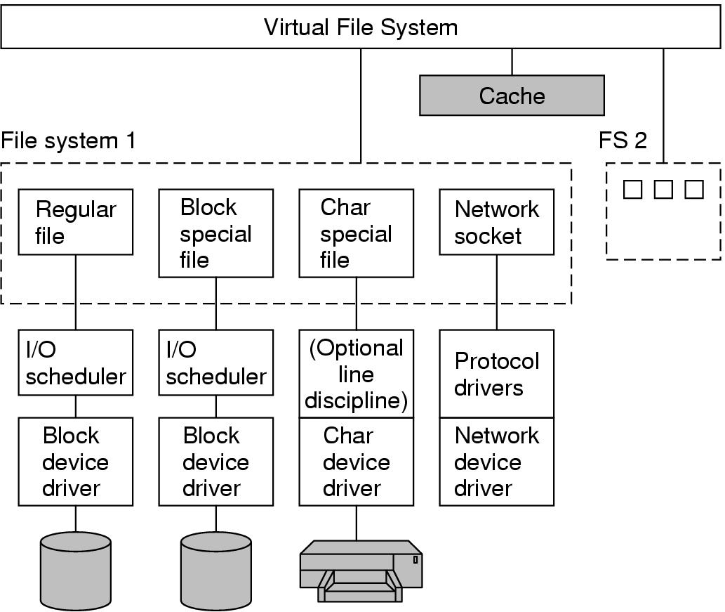
Implementation of
Input/Output in Linux (2)
Figure 10-22. The Linux I/O system showing one file system in detail.
Tanenbaum, Modern Operating Systems 3 e, (c) 2008 Prentice-Hall, Inc. All rights reserved. 0-13-6006639

Slide 34
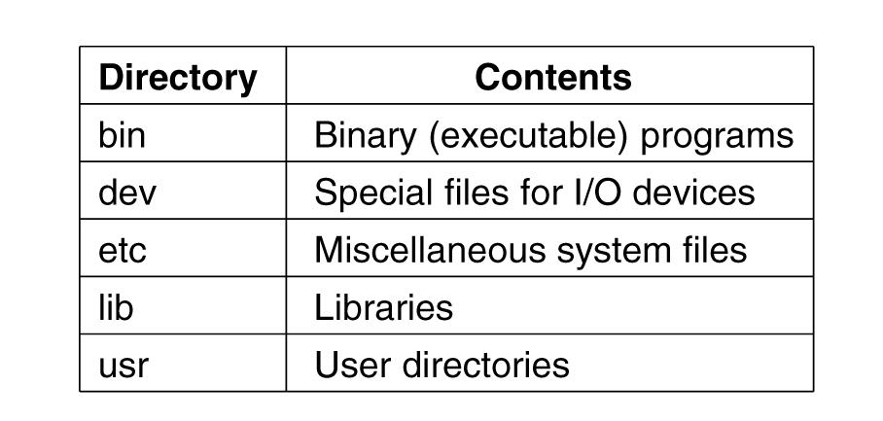
The Linux File System (1)
Figure 10-23. Some important directories
found in most Linux systems.
Tanenbaum, Modern Operating Systems 3 e, (c) 2008 Prentice-Hall, Inc. All rights reserved. 0-13-6006639

Slide 35
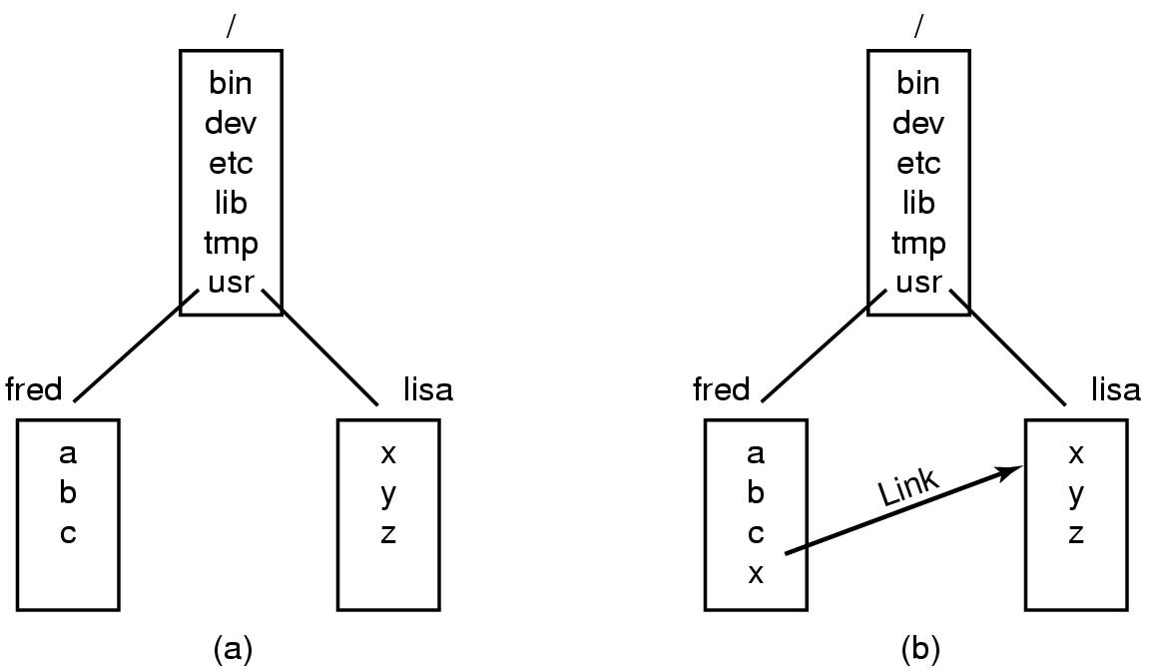
The Linux File System (2)
Figure 10-24. (a) Before linking. (b) After linking.
Tanenbaum, Modern Operating Systems 3 e, (c) 2008 Prentice-Hall, Inc. All rights reserved. 0-13-6006639

Slide 36
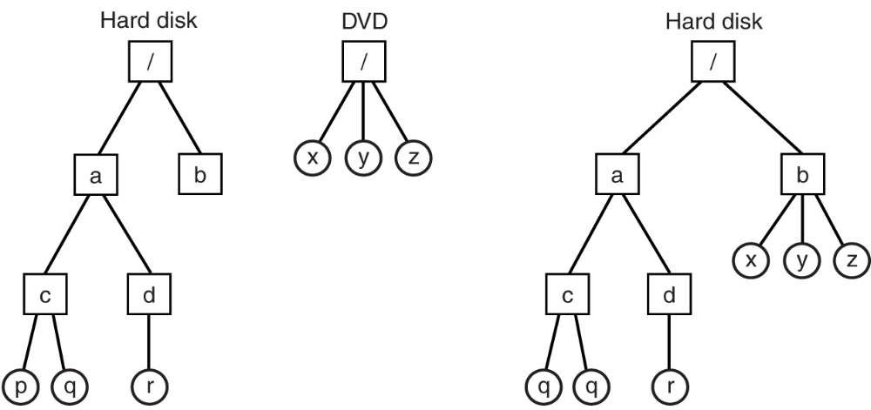
The Linux File System (3)
Figure 10-25. (a) Separate file systems. (b) After mounting.
Tanenbaum, Modern Operating Systems 3 e, (c) 2008 Prentice-Hall, Inc. All rights reserved. 0-13-6006639

Slide 37
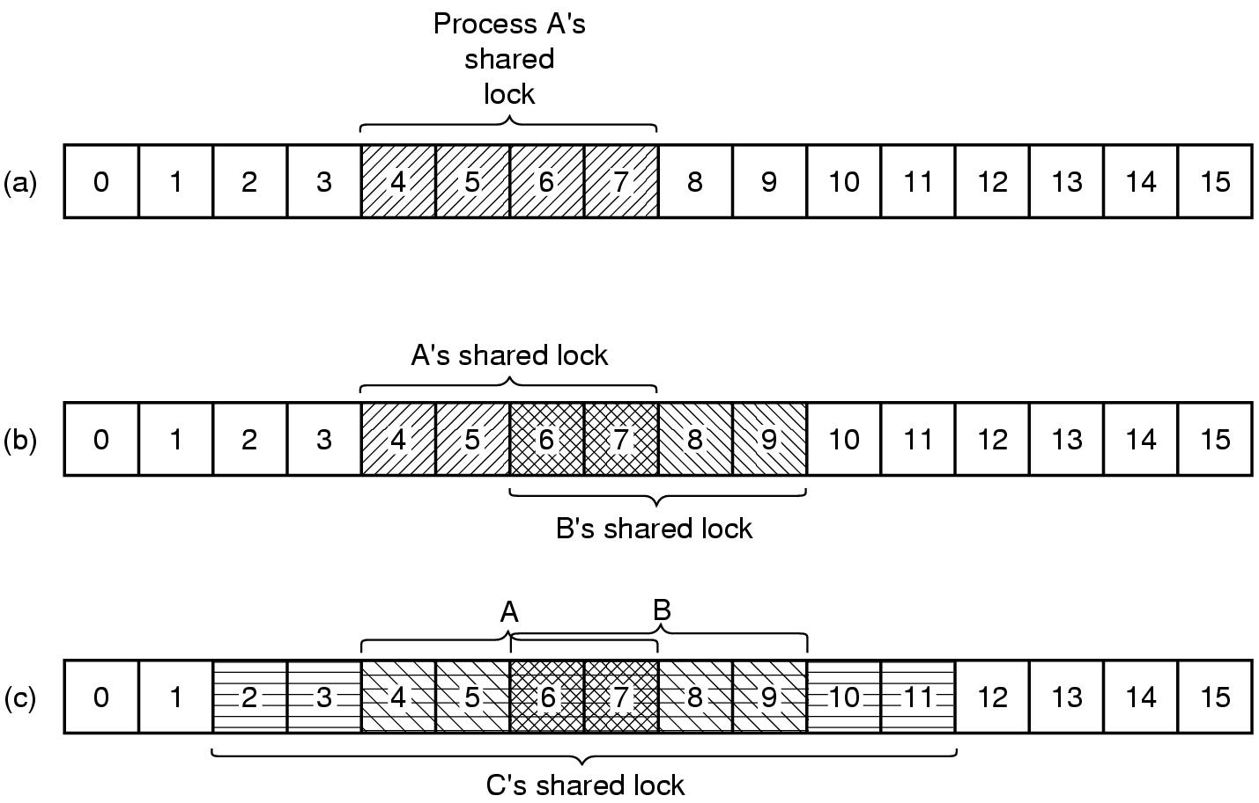
The Linux File System (4)
Figure 10-26. (a) A file with one lock.
(b) Addition of a second lock. (c) A third lock.
Tanenbaum, Modern Operating Systems 3 e, (c) 2008 Prentice-Hall, Inc. All rights reserved. 0-13-6006639

Slide 38
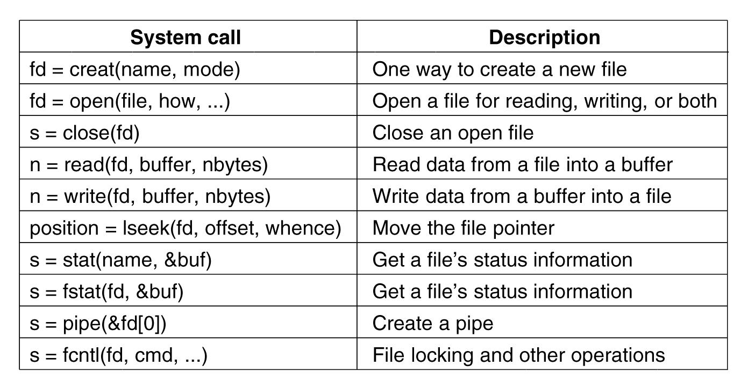
File System Calls in Linux (1)
Figure 10-27. System calls relating to files.
Tanenbaum, Modern Operating Systems 3 e, (c) 2008 Prentice-Hall, Inc. All rights reserved. 0-13-6006639

Slide 39
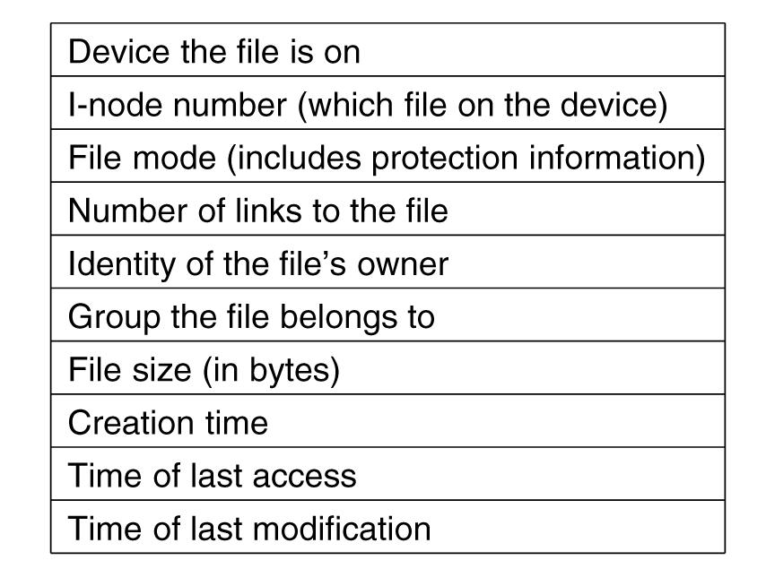
File System Calls in Linux (2)
Figure 10-28. The fields returned by the stat system call.
Tanenbaum, Modern Operating Systems 3 e, (c) 2008 Prentice-Hall, Inc. All rights reserved. 0-13-6006639

Slide 40
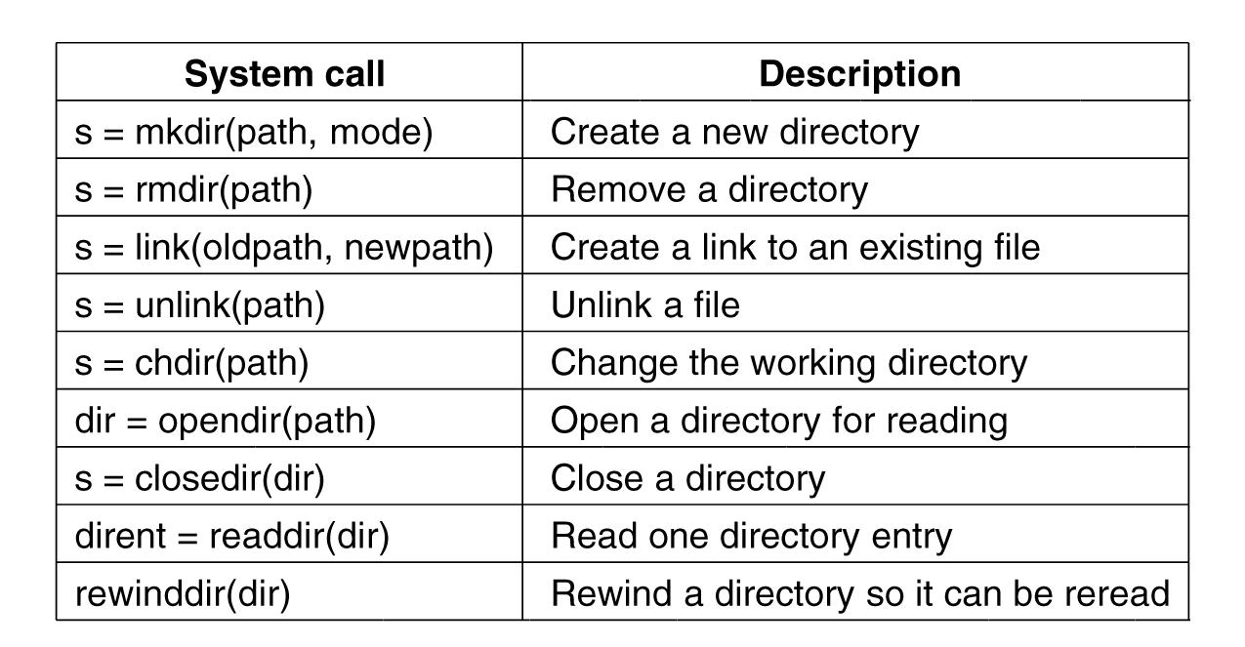
File System Calls in Linux (3)
Figure 10-29. System calls relating to directories.
Tanenbaum, Modern Operating Systems 3 e, (c) 2008 Prentice-Hall, Inc. All rights reserved. 0-13-6006639

Slide 41
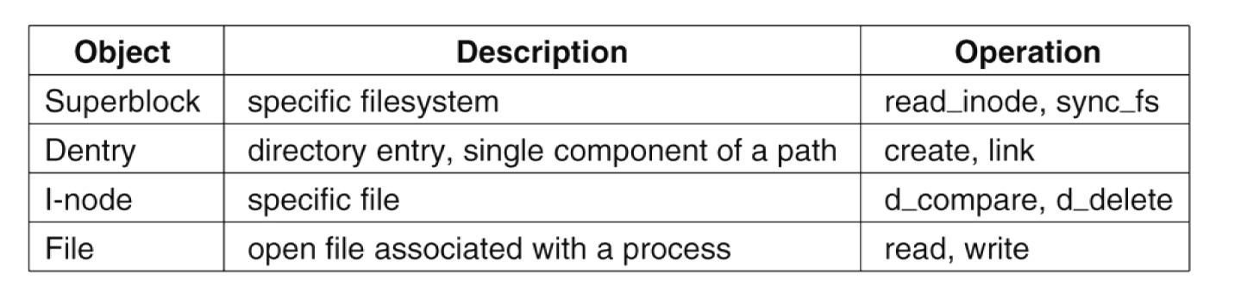
The Linux Virtual File System
Figure 10-30. File system abstractions supported by the VFS.
Tanenbaum, Modern Operating Systems 3 e, (c) 2008 Prentice-Hall, Inc. All rights reserved. 0-13-6006639

Slide 42
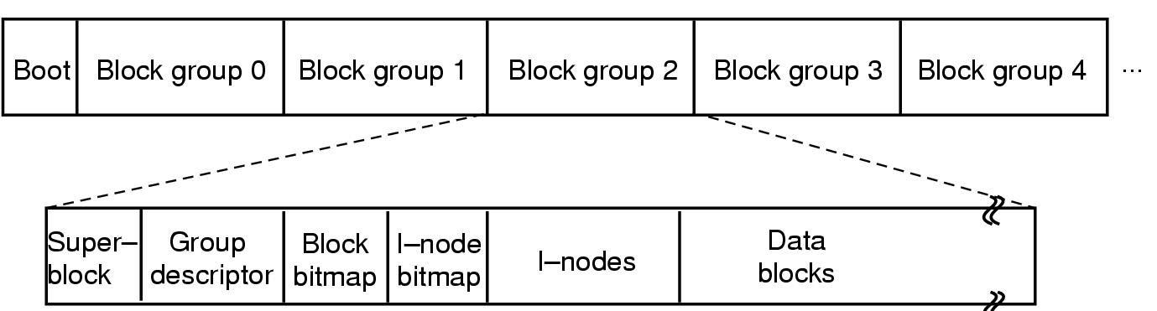
The Linux Ext2 File System (1)
Figure 10-31. Disk layout of the Linux ext2 file system.
Tanenbaum, Modern Operating Systems 3 e, (c) 2008 Prentice-Hall, Inc. All rights reserved. 0-13-6006639

Slide 43
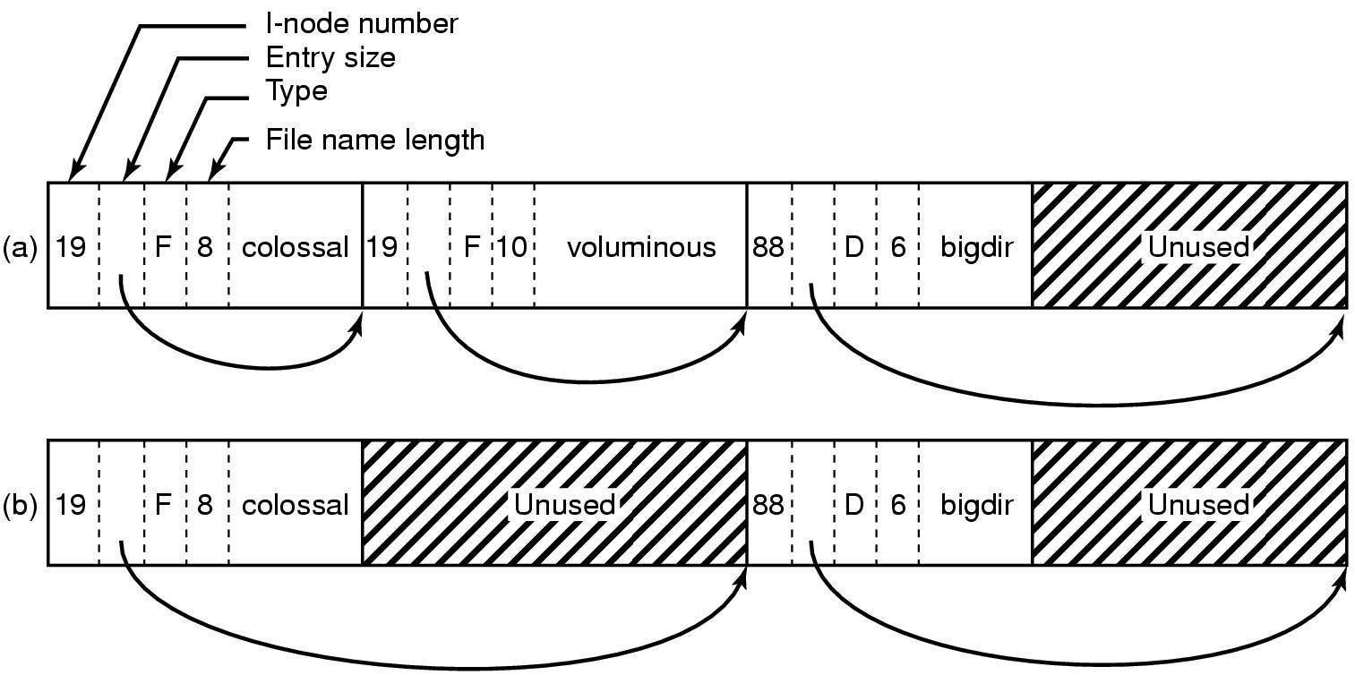
The Linux Ext2 File System (2)
Figure 10-32. (a) A Linux directory with three files. (b) The same directory after the file voluminous has been removed.
Tanenbaum, Modern Operating Systems 3 e, (c) 2008 Prentice-Hall, Inc. All rights reserved. 0-13-6006639

Slide 44
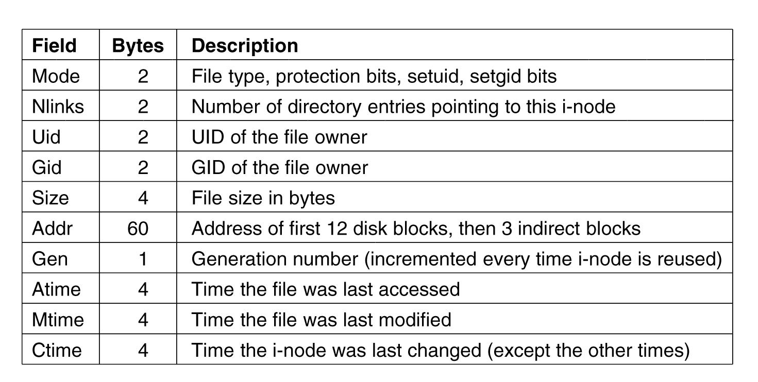
The Linux Ext2 File System (3)
Figure 10-33. Some fields in the i-node structure in Linux
Tanenbaum, Modern Operating Systems 3 e, (c) 2008 Prentice-Hall, Inc. All rights reserved. 0-13-6006639

Slide 45
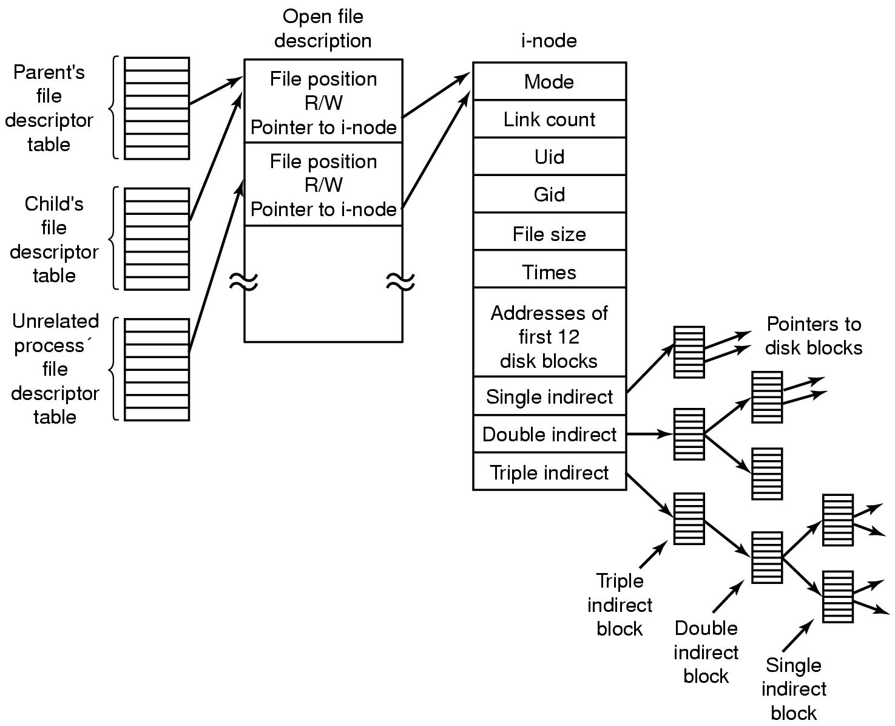
The Linux Ext2 File System (4)
Figure 10-34. The relation between the file descriptor table, the open file description table, and the i-node table.
Tanenbaum, Modern Operating Systems 3 e, (c) 2008 Prentice-Hall, Inc. All rights reserved. 0-13-6006639

Slide 46
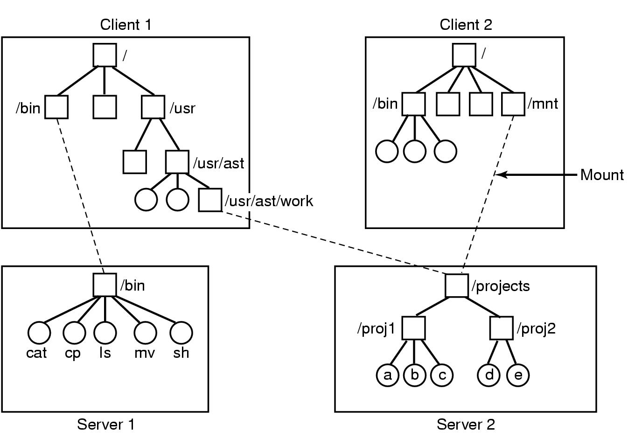
NFS Protocols
Figure 10-35. Examples of remote mounted file systems. Directories shown as squares, files shown as circles.
Tanenbaum, Modern Operating Systems 3 e, (c) 2008 Prentice-Hall, Inc. All rights reserved. 0-13-6006639

Slide 47
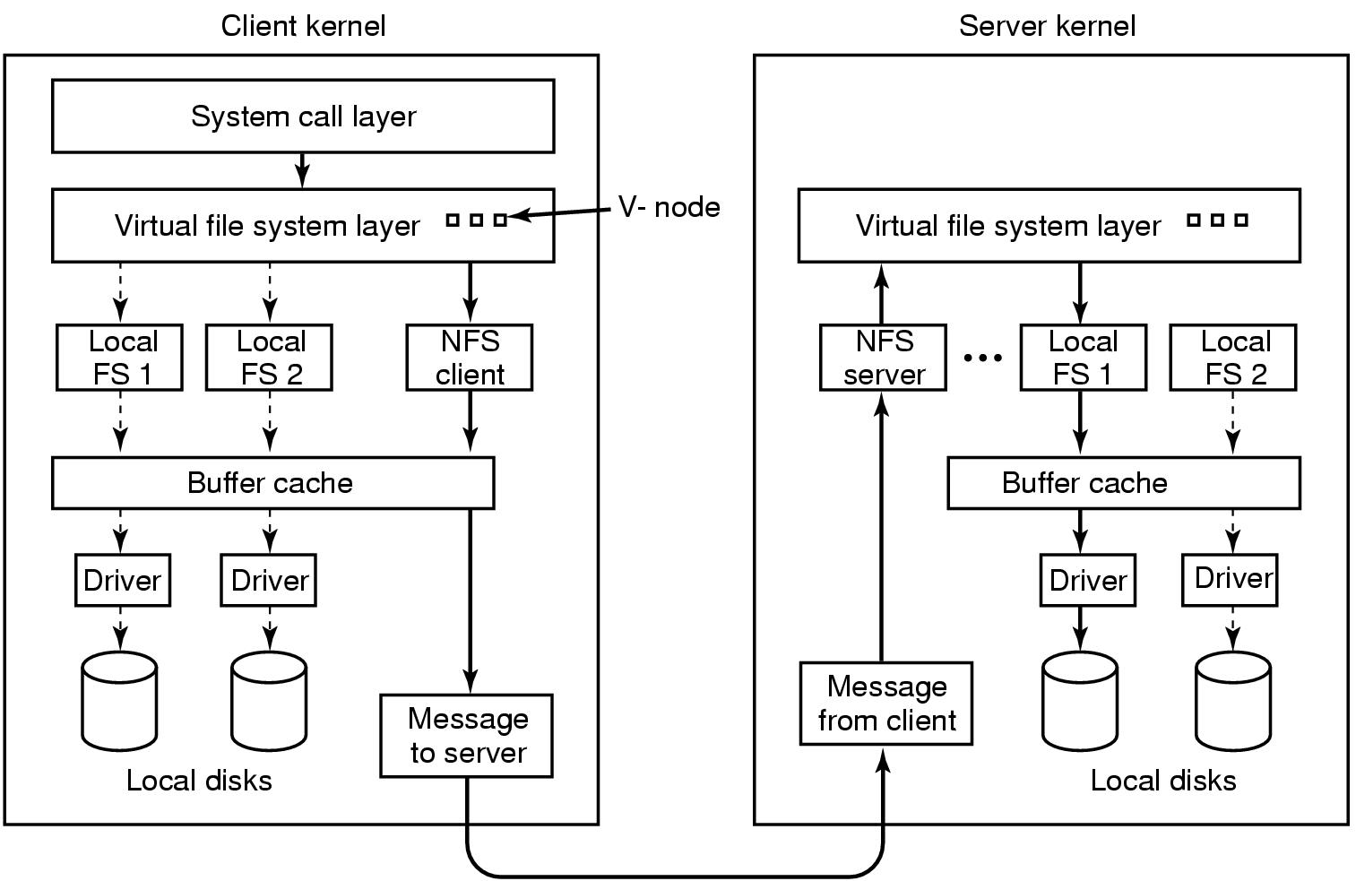
NFS Implementation
Figure 10-36. The NFS layer structure
Tanenbaum, Modern Operating Systems 3 e, (c) 2008 Prentice-Hall, Inc. All rights reserved. 0-13-6006639

Slide 48
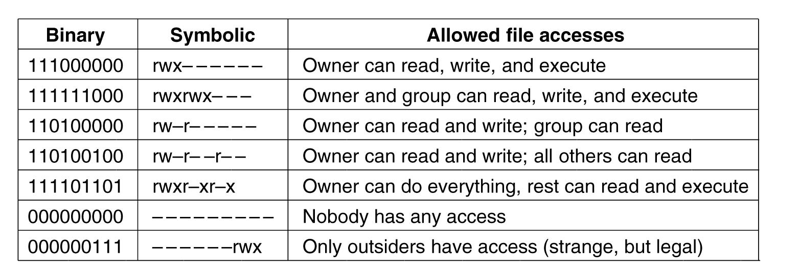
Security In Linux
Figure 10-37. Some example file protection modes.
Tanenbaum, Modern Operating Systems 3 e, (c) 2008 Prentice-Hall, Inc. All rights reserved. 0-13-6006639

Slide 49
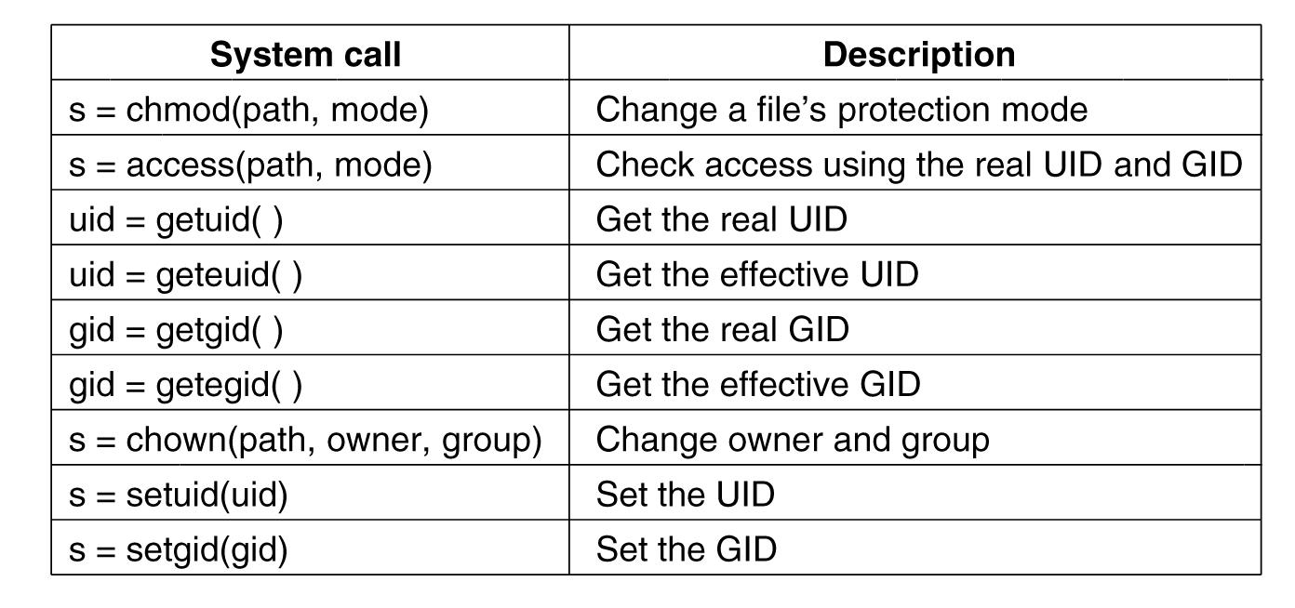
Security System Calls in Linux
Figure 10-38. system calls relating to security.
Tanenbaum, Modern Operating Systems 3 e, (c) 2008 Prentice-Hall, Inc. All rights reserved. 0-13-6006639

